Slide 1
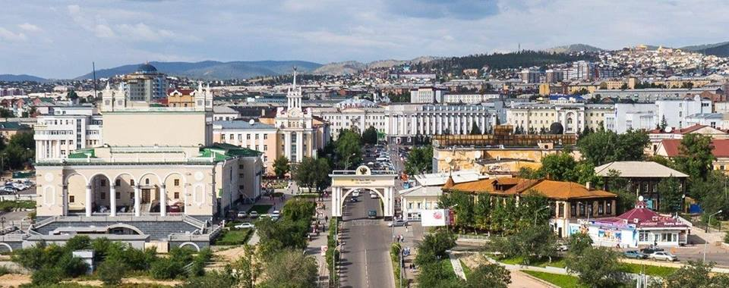
East Siberia State University of Technology and Management (ESSUTM)
http://www.esstu.ru

Slide 2
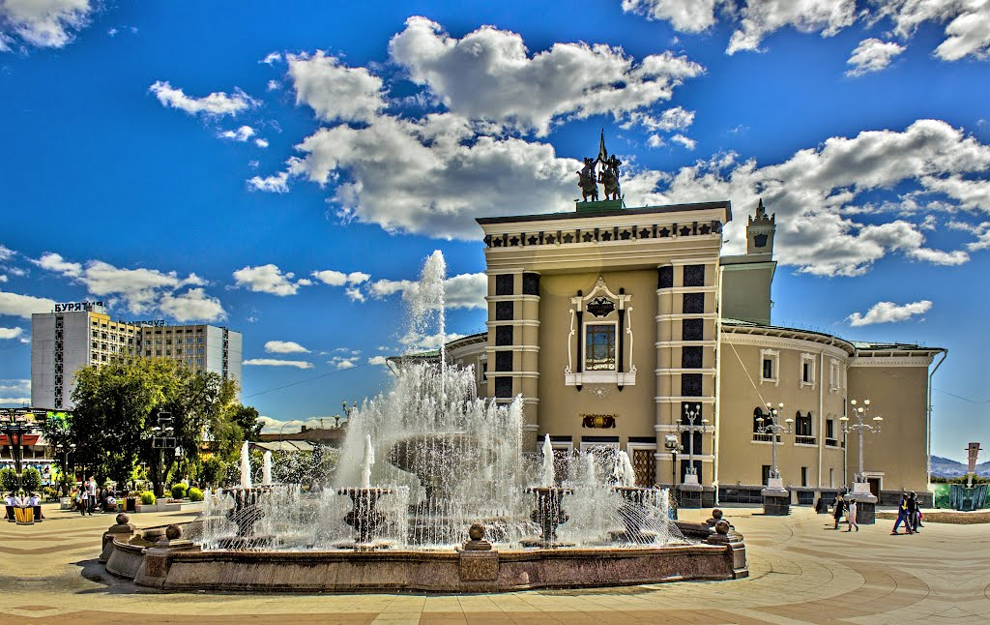
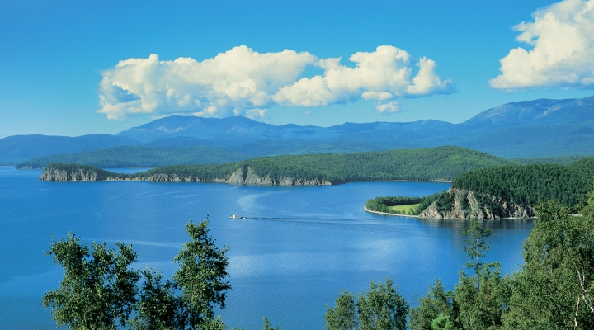
Republic of Buryatia
Republic of Buryatia is one of the most beautiful regions of the Russian Federation. The capital of Buryatia is Ulan-Ude city.
Buryatia lies along the eastern side of Lake Baikal, with a panhandle bordering Mongolia and extending westward beyond the southern end of the lake.
Lake Baikal is the oldest existing freshwater lake on Earth (20 million–25 million years old), as well as the deepest continental body of water, having a maximum depth of 1,620 meters.

Slide 3
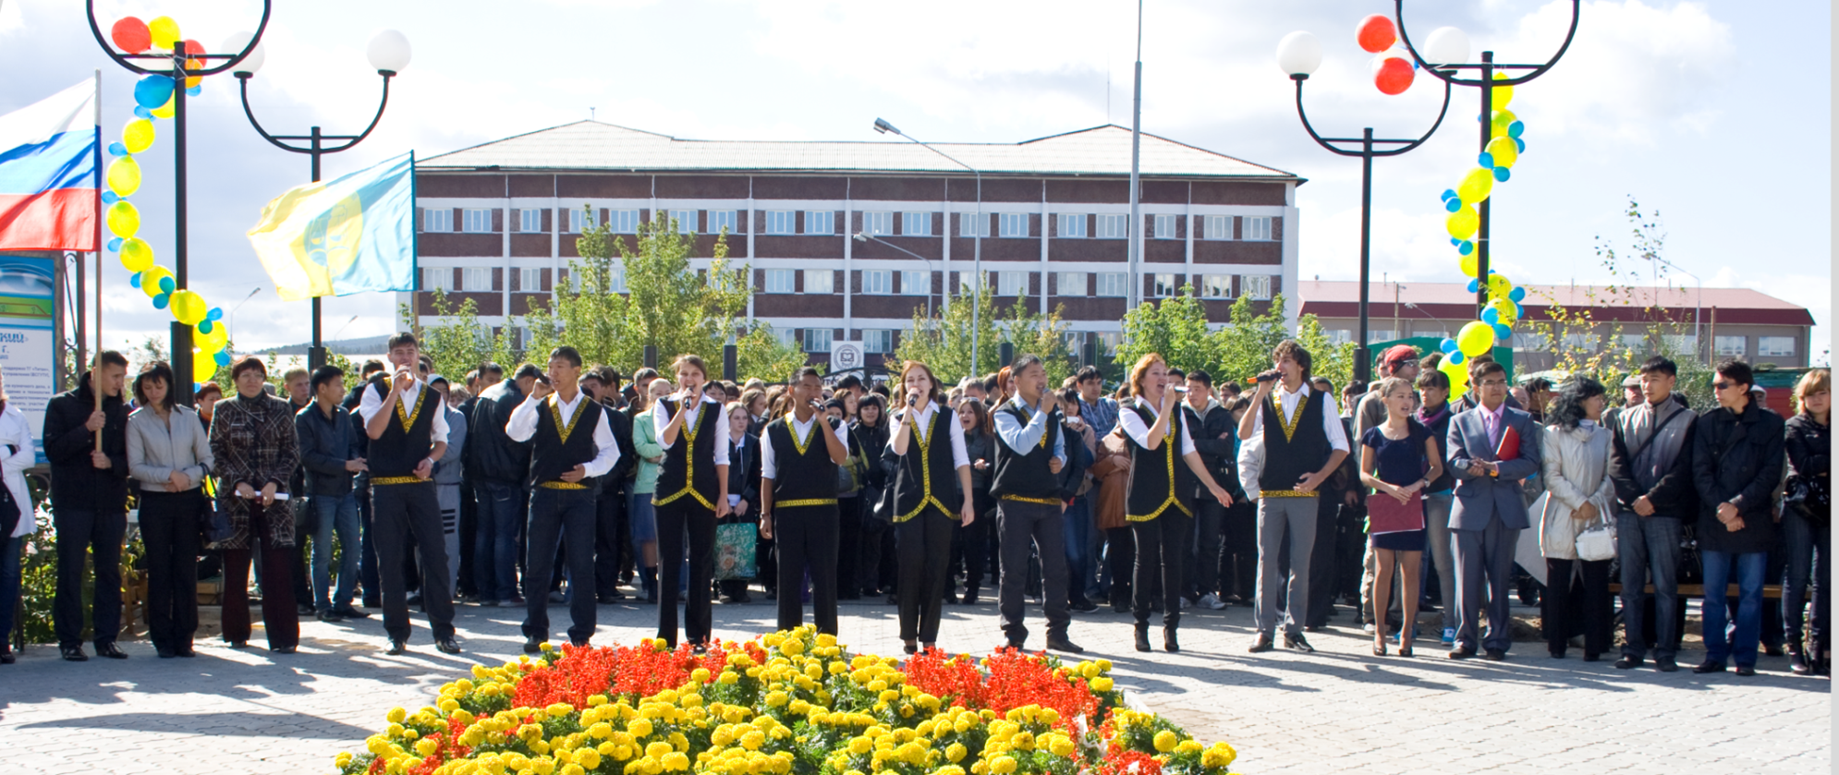
East Siberia State University of Technology and Management was founded in 1962 and has grown to be one of the foremost research and educational institutions of higher education in Siberia and the Far East.
Throughout its history the University graduated over 60000 highly skilled specialists for a wide range of world economic sectors.

Slide 4
ESSUTM today
is one of the leading educational and scientific centers with a well-developed infrastructure and up-to-date facilities.
realizes more than 80 basic licensed educational programs on full-time and part-time modes of study;
prepares scientific and teaching personnel in postgraduate study in 19 licensed scientific specialties, certification of science officers in 6 specialized councils of the University;

Slide 5
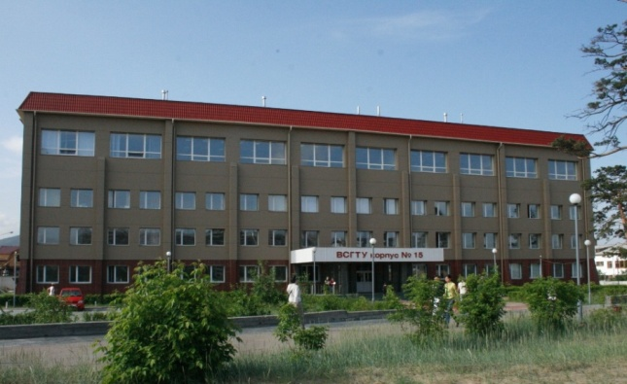
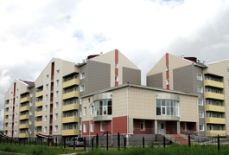
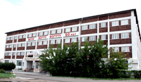
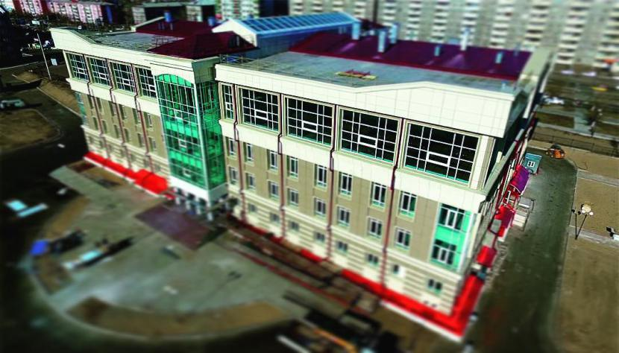
ESSUTM Structure
Administrative Body
Institutes:
Institute of Food Engineering and Biotechnology
Institute for Sustainable Development (2 Faculties)
Institute of Economics and Law (2 faculties)
Institute for personnel training
Faculties:
Faculty of Service, Technology and Design
Civil engineering faculty
Mechanical engineering faculty
Electrical engineering faculty
Preparatory Department

Slide 6
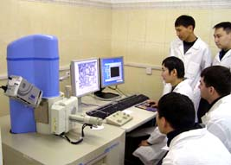
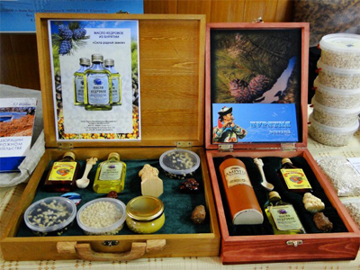
Scientific and industrial and technological base of the university include:
«Progress» common use center equipped with sophisticated tools and instruments for physical and chemical analysis
Plasma and energy technologies center
Geo-ecological research center
13 study and production facilities
9 minor innovative enterprises
In 2009 the University established regional student’s business incubator.

Slide 7
International Cooperation
The University actively develops international cooperation and has set up various contacts with the universities of China, Mongolia, France, Germany, Slovenia and others. Since 1992 more than 2000 citizens from China, Mongolia, Korea and USA others have been trained at the University. Today around 200 international students are getting Russian education at the University including students of the University’s foreign branch in Ulan-Bator, Mongolia.

Slide 8
Two-diploma educational programs:
1) University of Nice «Sophia
Antipolis» (France),
2) University of Informatics
«Neusoft» (China),
3) University of Maribor
(Slovenia).

Slide 9
Foreign partners
Wuhan Textile University; Chinese National office for Teaching Chinese as
a Foreign Language «Hanban»; Shenyang University of Technology; Manzhouli Professional college; Fur
company “Jiangnan”; Institute of international commerce at Jilin Russian language Institute; Manzhouli
State Institute at Inner Mongolia University; Overseas Chinese University; Liaoning university
Mongolian University of Science and Technology; Vitafit Invest Co., Ltd.; Leather research center
«Armono Corporation»; National University of Mongolia; Ulan-Bator technological university of food
Industry‘; Food research and manufacturing institute “Samo”; Leather research center “Armono
corporation”
Dresden University of Technology; F.A. Finger Institute for Building Material Engineering at Bauhaus
University,
University of Maribor
Adam Mickiewicz University in Poznan
Kyrgyz National University named after Jusup Balasagyn
Polessky State University, Republic of Belarus
University of Nice «Sophia Antipolis»
Korean technological institute of automatics “Katech”

Slide 10
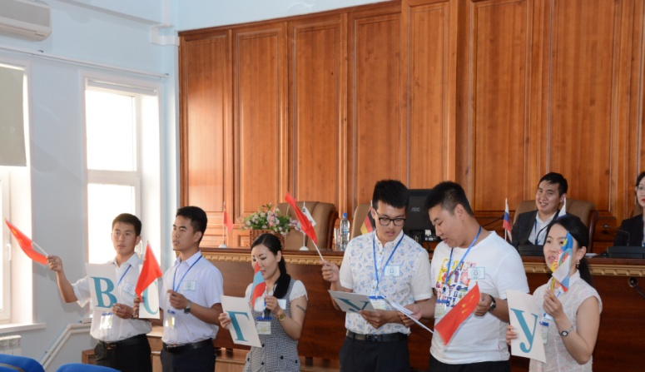
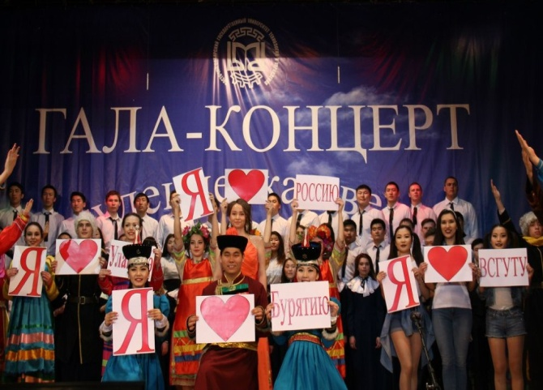
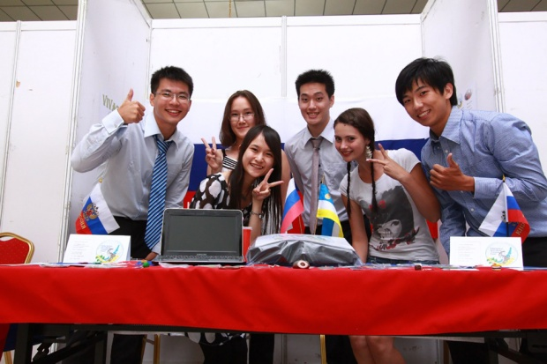
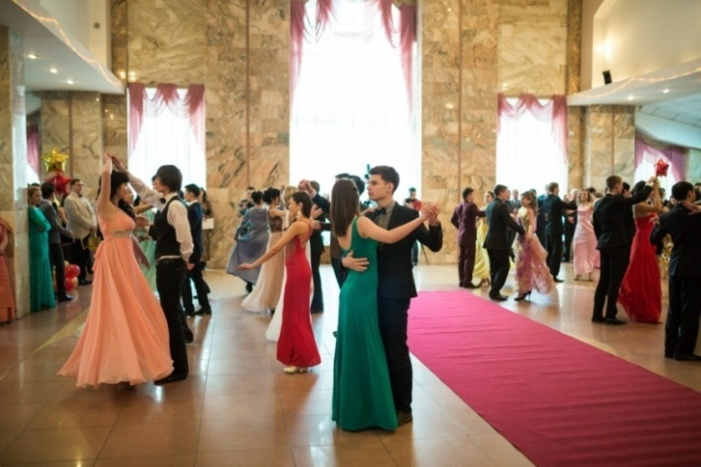
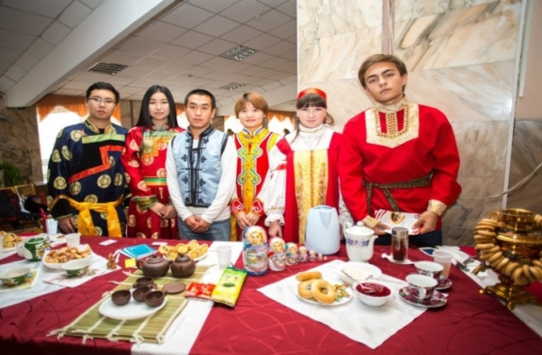
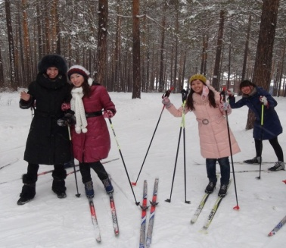
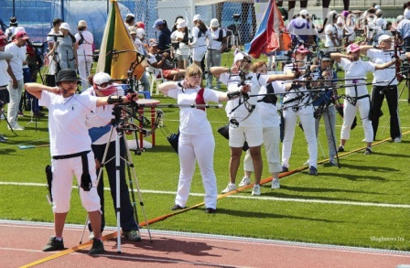
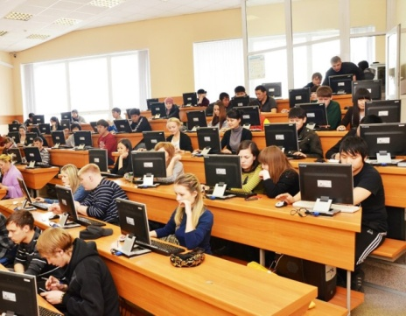
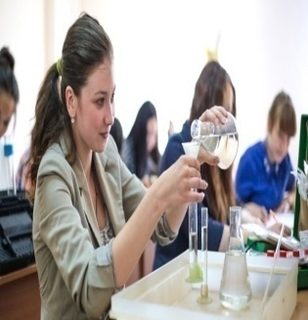
Students’ life

